Slide 1
Internet Group
Management Protocol
(IGMP)

Slide 2
CONTENTS
IGMP MESSAGES
IGMP OPERATION
ENCAPSULATION

Slide 3
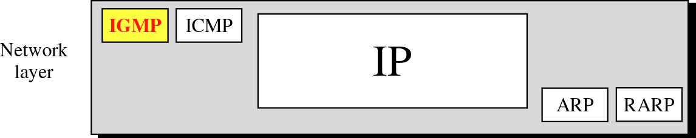
Figure 10-1
Position of IGMP in the network layer

Slide 4

IGMP is a group management
protocol. It helps a multicast router
create and update a list of loyal
members related to
each router interface.

Slide 5
10.2
IGMP
MESSAGES

Slide 6
2 types of msgs
Membership query msg
----- it can be used in 3 difft formats:
general
Grp specific
Grp and source specific
Membership report msg

Slide 7
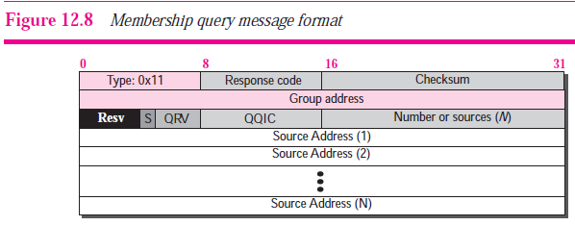

Slide 8
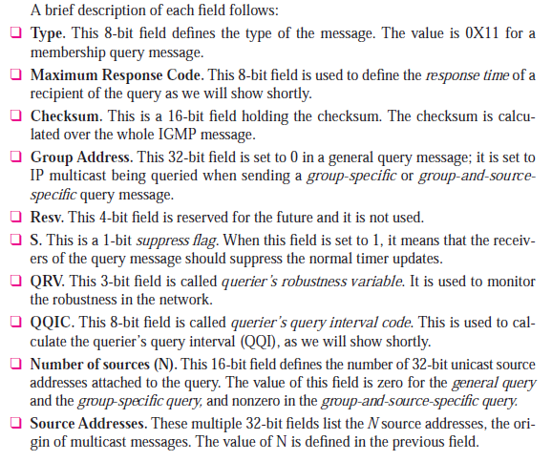

Slide 9
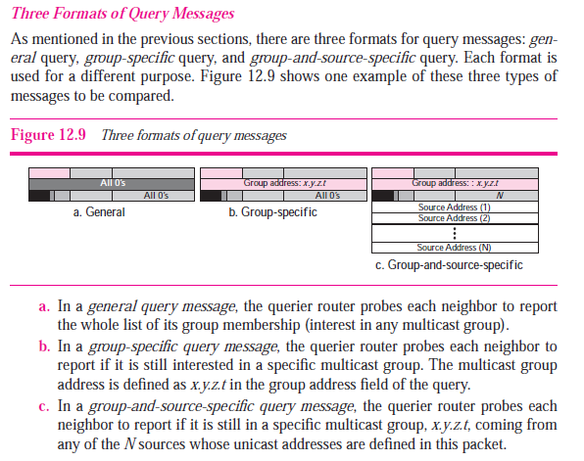

Slide 10
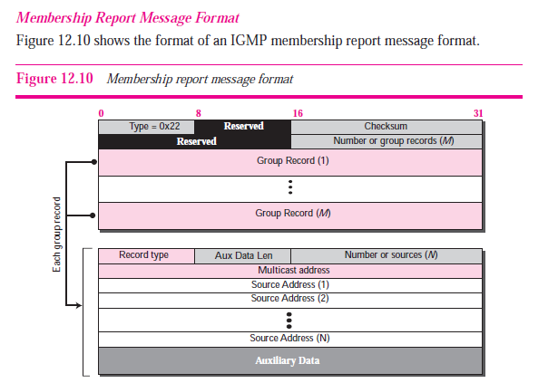

Slide 11
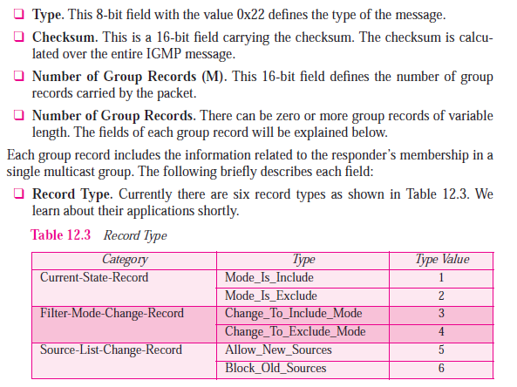

Slide 12
The following modes are used in IGMPv3:
Include mode - Data from the specified sources are filtered and forwarded towards the hosts by the multicast router.
Exclude mode - Data from the specified sources are filtered and not forwarded towards the hosts.

Slide 13
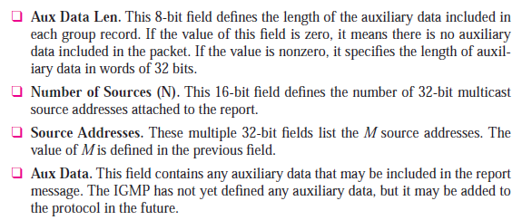

Slide 14
Example 1
Imagine there are three hosts in a network as shown in Figure 10.8 (next slide).
Imagine there are three hosts in a network as shown in Figure 10.8 (next slide).
A query message was received at time 0; the random delay time (in tenths of seconds) for each group is shown next to the group address. Show the sequence of report messages.

Slide 15
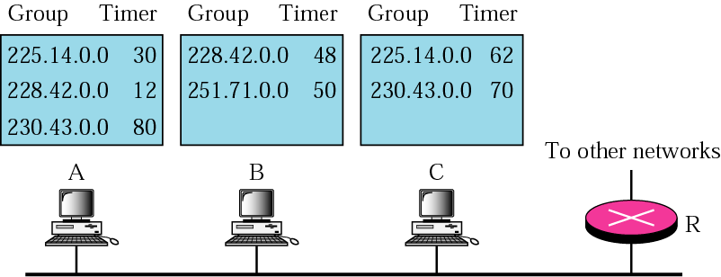
Figure 10-8
Example 1

Slide 16
Solution
The events occur in this sequence:
Time 12: The timer for 228.42.0.0 in host A expires and a membership report is sent, which is received by the router and every host including host B which cancels its timer for 228.42.0.0.
Time 30: The timer for 225.14.0.0 in host A expires and a membership report is sent, which is received by the router and every host including host C which cancels its timer for 225.14.0.0.

Slide 17
Figure 10-8
Example 1

Slide 18
Solution (Continued)
Time 50: The timer for 251.70.0.0 in host C expires and a membership report is sent, which is received by the router and every host.
Time 70: The timer for 230.43.0.0 in host C expires and a membership report is sent, which is received by the router and every host including host A which cancels its timer for 230.43.0.0.
Note that if each host had sent a report for every group member in its list, there would have been seven reports; with this strategy only four reports are sent.

Slide 19
10.4
ENCAPSULATION

Slide 20
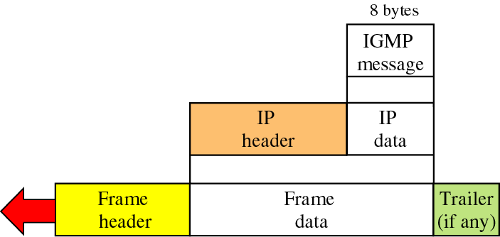
Figure 10-9
Encapsulation of IGMP packet

Slide 21
The IP packet that carries
an IGMP packet has a value of
2
in its protocol field.

Slide 22
The IP packet that carries
an IGMP packet has a value of
1
in its TTL field.

